Slide 1
Measuring Apoptosis using Flow Cytometry
Rich Hastings
KUMC Flow Cytometry Core Lab
3901 Rainbow Boulevard
Kansas City, KS 66160
913-588-0627
rhastings@kumc.edu
http://www.kumc.edu/flow/

Slide 2
Cell Membrane
Cell membrane integrity → vital for proper cell functioning.
Most cells can only withstand transient ruptures of the cell membrane.
If the cell membrane suffers massive breaches -loses the ability to accumulate and contain vital components and will be subject to outside toxins.
There is a term for cells that suffer massive cell membrane trauma - Dead Cells.

Slide 3
Membrane Exclusion
Trypan Blue has been used for years to assess cell viability.
Trypan Blue is negatively charged, and does not bind to the cell unless the membrane is compromised.
Viable cells exclude Trypan Blue. Time sensitive.
Another method to assess cell viability is dye exclusion, using an impermeant dye.
If the cell takes up the impermeant dye, it is considered dead.
Cells that become reproductively non viable (ie,ionizing rad): impermeant dye is useless.
Notes:
The longer cells are incubated with Trypan Blue the more they will take up the dye.
An impermeant dye is a compound that can only get into the cell when the membrane has been compromised.

Slide 4
Impermeant Dyes
Propidium Iodide
Excited by 488 nm laser light.
Emits at 620 nm (Looonnnggg emission curve).
Binds to DNA, intercalating between bases with no specificity, one dye molecule/4-5 bp.
7-Aminoactinomycin D (7-AAD)
Excited by 488 nm laser light.
Emits at 647 nm.
Binds to DNA and inserts between Cytosine and Guanine bases of double stranded DNA when the interior of the cell and chromatin is accessible. Positively stained cells are considered non-viable as 7-AAD has crossed a no longer intact cell membrane.

Slide 5
Apoptosis
Programmed Cell Death
Characterized by DNA fragmentation and Δ in cell morphology and volume.
Requires biochemical energy.
Important – normal functioning of the immune system, embryonic development, normal tissue maintenance and chemical- and hormone-induced cell death.
‘Programmed’-genetically determined eradication of cells.
Normal cell development, aging, and security mechanism.
Necessary and Pathological.
Removal of specific cells w/o inflammation.
Notes:
Many different stimuli and conditions can induce apoptosis.

Slide 6
Apoptosis vs. Necrosis
Necrosis
Toxicity-induced cell death.
Requires no energy, passive.
Cells swell and then karyolysis (dissolution of the chromatin and nucleus - DNase).
Release of cellular contents may cause inflammation.
Apoptosis
‘Stimulation’-induced cell death.
Energy required.
Cell shrinkage, then pyknosis (chromatin condenses), followed by karyorrhexis (fragmentation of the nucleus).
Do not release cellular contents and are readily phagocytosed by macrophages.
Notes:
Necrosis is a degradative process. Apoptosis is a controlled physiological process.

Slide 7
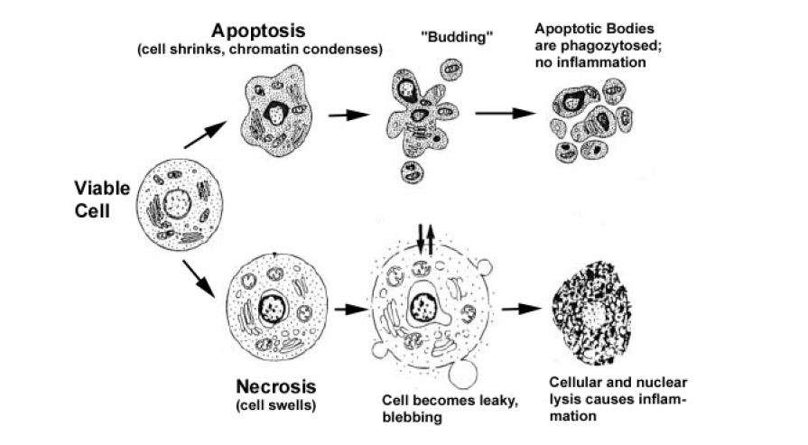
Apoptosis vs. Necrosis
From: Andreas Gewies, Intro to Apoptosis
Notes:
Cartoon of Apoptosis vs Necrosis.

Slide 8
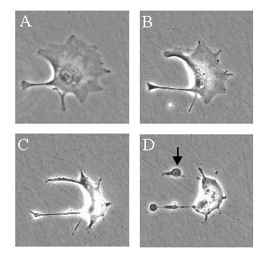
Apoptosis
Apoptotic Effects - Cell Morphology
Change shape and shrink during apoptosis.
Chromatin condenses in a process called Pyknosis.
The cells become smaller and the cytoplasm shrinks around the organelles.
Figure from the Cell Migration Lab, University of Reading
http://www.reading.ac.uk/cellmigration/apoptosis.htm
Notes:
Cell begins to shrink
The Chromatin condenses
The cell really shrinks
Cells package themselves to be removed by macs and other cells.

Slide 9
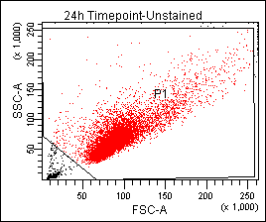
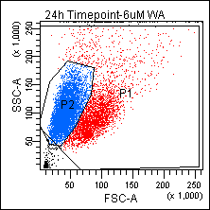
Apoptosis
Apoptotic Effects - Cell Morphology
No Treatment Treatment
Cells became smaller and more granular (Blue Cells).
Notes:
Cells became smaller and more granular as the membrane is stripped away.

Slide 10
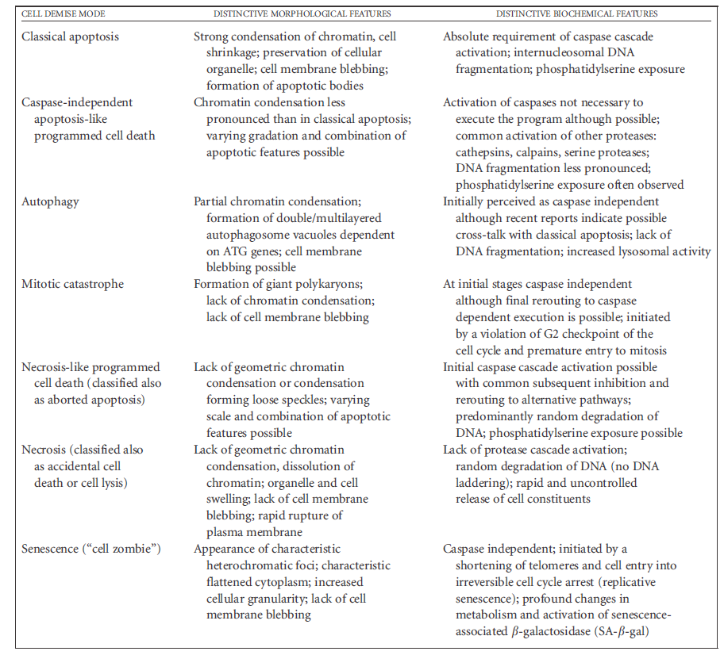
Apoptosis
From: Wlodkowic, D (2010). Cytometry in Cell Necrobiology Revisited. Recent Advances and New Vistas. Cytometry 77A: 591-606.
Notes:
The body of knowledge, many different types of cell death.

Slide 11
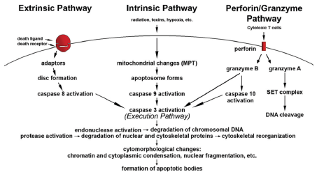
Apoptosis
Pathways
Extrinsic (‘Death Receptor’)
Intrinsic (Mitochondria)
Perforin/Granzyme (T-cell mediated)
From: Elmore, S. A. (2007). Apoptosis: a review of programmed cell death. Toxicol Pathol 35 (4):495-516.

Slide 12
Apoptosis
Extrinsic (‘Death Receptor’)
Ligands/Receptors implicated in the induction of apoptosis:
FasL (CD178)/Fas (CD95)
TNF-α/TNFR1
Apo3L/DR3
Apo2L/DR4
Apo2L/DR5
Binding creates a death-inducing signaling complex (DISC) to be formed.
Activation of procaspase-8, starts execution phase of apoptosis.
Notes:
Trans-membrane receptors that are members of the TNF receptor gene super-family. Caspase enzymes, the name applied to cysteine-aspartic
acid specific proteases.

Slide 13
Apoptosis
Intrinsic (Mitochondria)
Negative stimuli - Stop the suppression of apoptosis
Lack of certain growth factors, hormones or cytokines.
Positive stimuli – Induce apoptosis
Free radicals, radiation, hypoxia, infections, and toxins.
Initiated at the inner mitochondrial membrane.
Loss of mitochondrial membrane potential and the release of pro-apoptotic proteins.
One set of proteins activate the caspase-dependent mitochondrial pathway.
The later group activates AIF (Apoptosis-Inducing Factor) and endonuclease proteins.
Bcl-2 family of proteins mediate mitochondrial apoptosis.

Slide 14
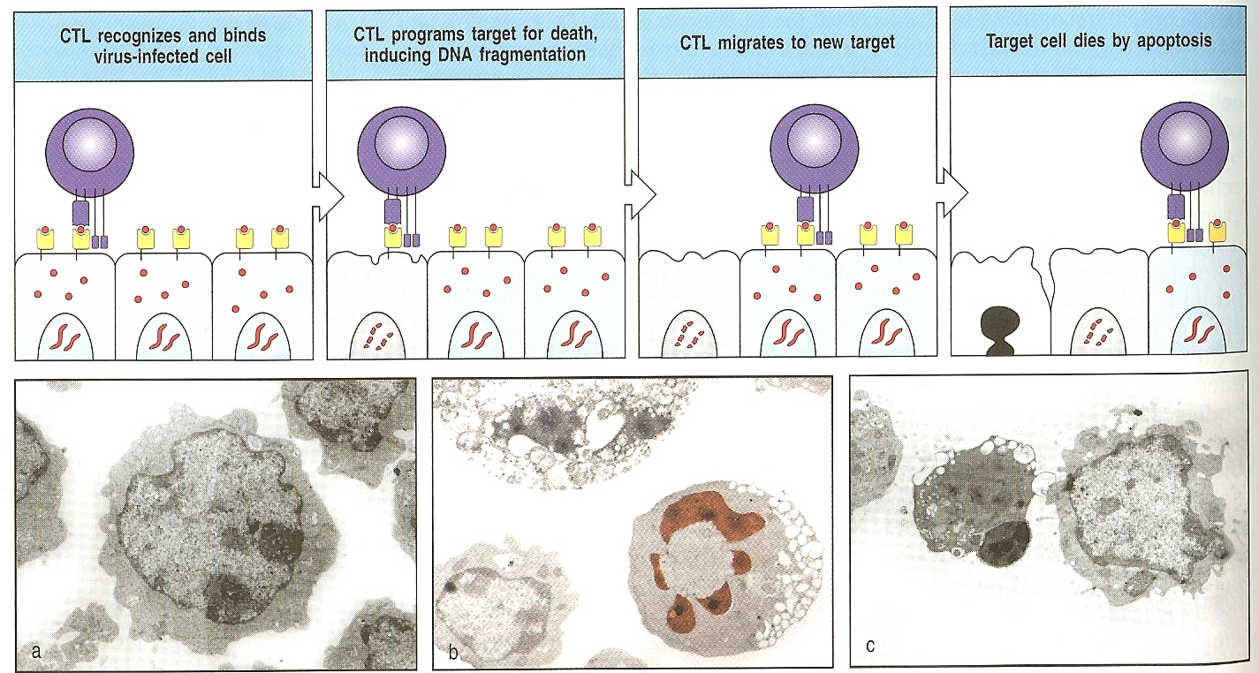
Apoptosis
Perforin/Granzyme (T-cell mediated)
Healthy Cell
Apoptotic Cell
From: Janeway’s Immunology, Seventh Edition, 2008.
Notes:
Top panels show a cytotoxic T-cell inducing apoptosis in a virally –infected cell. Receptor binding followed by release of cytotoxic proteins stored in in granules.
Bottom panels: a. Healthy target cell
b. Chromatin (red) shrinks in target cell, cytoplasm still intact, cell in upper left is necrotic and is falling apart.
c. Middle cell is apoptotic, nucleus is condensed, no mitochondria, most of the membrane and cytoplasm has been lost via the shedding of vesicles.

Slide 15
Apoptosis
Execution Pathway
Final Pathway for Apoptosis.
Caspases activate cytoplasmic endonuclease and proteases.
From: Elmore, S. A. (2007). Apoptosis: a review of programmed cell death. Toxicol Pathol 35 (4):495-516.
Notes:
Caspase 3 is the most important caspase in the execution phase. C3 activates endonuclease CAD, CAD degrades chromosomal DNA, causing chromatin condensation. Caspase 3 is involved in the reorg of the cytoskeleton and the transformation of the cell into apoptotic bodies.

Slide 16
Apoptosis
Apoptosis Inducing Compounds:
Compound | Mechanism(s) of Action
Actinomycin D | Caspase-3 activity increased more than 20-fold, inhibition of rRNA synthesis and the defective pre-mRNA maturation
Brefeldin A | caspase activation
Camptothecin | prevents DNA re-ligation and therefore causes DNA damage
Colchicine | mediated through cytochrome C release and caspase-3 activation
Doxorubicin.HCl | early activation of p53 in tumor cells that was followed by caspase-3 activation and DNA fragmentation
Ionomycin | induces the activation of calcium-dependent endonuclease
Mitomycin C | Inhibitor of DNA synthesis
Staurosporine | caspase-independent and dependent mechanisms
Thapsigargin | Bax-dependent signaling pathway controlling the cytosolic release of mitochondrial apoptogenic molecules
Notes:
We have Camptothecin in the core.

Slide 17
Apoptosis Assays
Apoptosis is complex and tightly regulated.
Many assays are available.
Advantages and Disadvantages:
Apoptosis and Necrosis have overlapping phenomena.
Do you want to detect initiation of apoptosis?
Or the execution phase?
Kinetics of cell death can be tricky.
Notes:
Caspases may be expressed only transiently, you may miss your time window because apoptotic cells may die quickly, and perhaps only a few cells are apoptotic at the time of analysis.

Slide 18
Apoptosis Assays
Where in the pathway?
DNA Fragmentation -TUNEL assay.
Caspase Detection – PhiPhiLux and Vybrant FAM Poly Caspases Assay Kit.
Chromatin Condensation - Vybrant® DyeCycle™ Violet/SYTOX® AADvanced™ Apoptosis Kit for Chromatin Condensation (Invitrogen cat # A35135).
Membrane Alteration – Annexin V, and Membrane Permeability.
Mitochondria - MitoProbe™ JC-1 Assay Kit for Flow Cytometry (Invitrogen cat # M34152).

Slide 19
TUNEL Assay
TUNEL (Terminal dUTP Nick-End Labeling)
During Apoptosis, Genomic DNA is cleaved into small double-stranded fragments and single-stranded breaks called ‘nicks’.
Terminal deoxynucleotidyl transferase (TdT) labels DNA strand breaks by catalyzing the polymerization of labeled nucleotides to free 3’-OH DNA ends.
The 3′-OH ends of the breaks can be detected by attaching a fluorochrome. This is generally done directly or indirectly (biotin) using fluorochrome-labeled deoxynucleotides in a reaction catalyzed preferably by TdT.
Best results are achieved using a positive control (fixed, permeabilized cells treated with DNase) and a negative control (no FITC labeling reagent).
We have had good luck with the Roche kit (cat # 11 684 795 910).
Notes:
The labeling is template independent.
The Roche kit is expensive ~ $500.

Slide 20
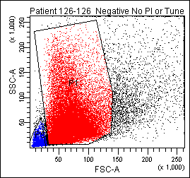
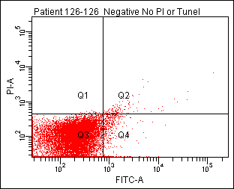
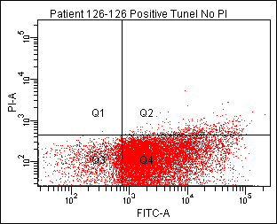
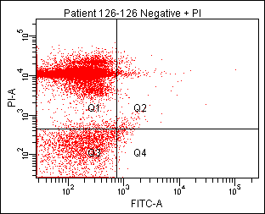
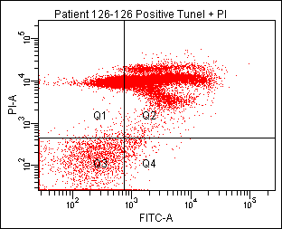
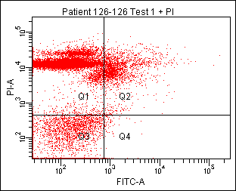
TUNEL Assay
Gated on Sperm
Negative Control
Tunel FITC, No PI Positive Control
No Tunel, PI Only Positive Control
Tunel FITC and PI Positive Control
Tunel FITC and PI Test
Notes:
The dot plots are of human sperm stained with a TUNEL FITC reagent and PI.
First, we gate on the sperm, then gate on our unstained negative control. We use our TUNEL-FITC positive control (treated with DNase) for PI -%FITC compensation control. We then subtract out FITC - %PI compensation on the PI only control.

Slide 21
TUNEL Assay
Sperm Tunel Assay |  |  | 2/29/2012
All values are percentages.
Date | Patient | Negative Control | Positive Control | TUNEL FITC Test Rep. 1 | TUNEL FITC Test Rep. 2 | TUNEL FITC Test Rep. 3 | TUNEL FITC Test Rep. 4 | Mean | Standard Deviation
11/18/2011 | #111 | 1.4 | 93 | 19.1 | 19 | 18.6 |  | 18.90 | 0.26
11/21/2011 | #122 | 1 | 83.9 | 34.7 | 30.5 | 30 | 37.5 | 33.18 | 3.57
11/21/2011 | unknown | 2.9 | 94.7 | 18.9 | 19.9 | 20.9 |  | 19.90 | 1.00
11/23/2011 | unknown | 1.3 | 90 | 36.1 | 26.1 | 23 |  | 28.40 | 6.85
11/28/2011 | #113 | 1.1 | 92 | 52.3 | 51.9 | 52 |  | 52.07 | 0.21
11/28/2011 | #114 | 0.7 | 18.1 | 3.4 | 3.8 | 1.9 |  | 3.03 | 1.00
12/12/2011 | #117 | 2 | 97.2 | 90 | 87.6 | 91 | 90 | 89.65 | 1.45
12/19/2011 | #118 | 1.7 | 8.6 | 5.9 | 4.5 | 3 |  | 4.47 | 1.45
1/6/2012 | #123 | 1.3 | 79.3 | 11 | 9.8 | 9.3 | 45.9 | 19.00 | 17.95
1/6/2012 | #123 | 1.3 | 79.3 | 11 | 9.8 | 9.3 | 45.9 | 10.03 | 0.87
1/9/2012 | #119 | 1.9 | 81.1 | 11.7 | 10.8 | 11.1 |  | 11.20 | 0.46
1/12/2012 | #122 | 0.8 | 84.3 | 10.2 | 12.5 | 12.3 |  | 11.67 | 1.27
1/23/2012 | #120 | 1.7 | 67.3 | 7.5 | 8.6 | 8.2 |  | 8.10 | 0.56
1/23/2012 | #121 | 0.6 | 83.7 | 15.4 | 15.9 | 14.7 |  | 15.33 | 0.60
1/26/2012 | #124 | 3.7 | 95.9 | 26 | 22.2 | 25 |  | 24.40 | 1.97
1/30/2012 | #130 | 3.9 | 91.7 | 13.8 | 13 | 13.7 | 12.6 | 13.50 | 0.44
2/6/2012 | #131 | 3.1 | 43.6 | 8.1 | 8.4 | 7 |  | 7.83 | 0.74
2/13/2012 | #126 | 0.6 | 63.2 | 8.8 | 8.7 | 8.6 |  | 8.70 | 0.10
2/13/2012 | #132 | 1 | 79.6 | 7.3 | 7.1 | 7 |  | 7.13 | 0.15
2/27/2012 | #135 | 1.6 | 29.2 | 6.9 | 5 | 5.5 |  | 5.80 | 0.98
2/27/2012 | #136 | 2.9 | 78.5 | 35.6 | 25.4 | 24 |  | 28.33 | 6.33
Excluded from mean and standard deviation.
<50%
Notes:
Here is a table of representative TUNEL data. In some cases, the positive control is below 50% FITC+. Our explanation is sometimes the cells clump and we have problems re-suspending those cells and this effects the DNase treatment. The replicates for the test samples are remarkably consistent.

Slide 22
TUNEL Assay
Advantages
Assay is very sensitive. Can detect ~100 cells (flow cytometry).
Fast, can be completed in 3 hours.
High reproducibility, with good precision.
Paraformaldehyde fixation before permeabilization prevents the loss of small fragments of DNA.
Disadvantages
We do not know how many strand breaks are necessary for detection.
Necrotic cells can generate false positives.
Detergent is used to permeabilize the cells. Apoptotic cells in saline + detergent are extremely fragile and can be lysed when pipetted or vortexed.
Notes:
The labeling is template independent.
The Roche kit is expensive ~ $500.

Slide 23
Caspase Assay
PhiPhiLux staining from OncoImmunin, Inc.
A fluorescent cmpd is dimerized w/ a peptide linker.
The proximity of the 2 cmpds quenches their fluorescence.
Cmpd is taken up by cells.
Linker (DEVDGI) is specific for Caspase 3.
When the linker is cut they fluoresce.
Available in green and red substrates.
Add PI, PI⁺ cells are not green as the PhiPhiLux reagent diffuses out.
Notes:
Why does the PhiPhiLux reagent diffuse out of PI+ cells, they lack membrane integrity.

Slide 24
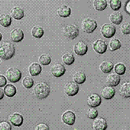
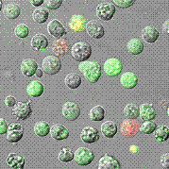
Caspase Assay
PhiPhiLux staining from OncoImmunin, Inc.
SKW6.4 Cells
Control
Anti-Fas
Micrographs from http://www.phiphilux.com/phi1.html
Notes:
SKW6.4 cells (lymphoblastoid cell line)
Notice the bright green staining in the anti-Fas ligand rx, green cells are apoptotic with intact membranes, red cells are permeable for a red DNA stain.

Slide 25
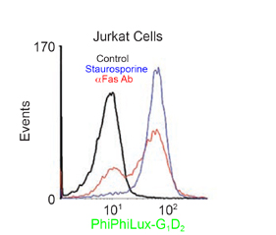
Caspase Assay
PhiPhiLux staining from OncoImmunin, Inc.
From: Packard, BZ. (2008). Intracellular protease activation in apoptosis. Cell Research 18: 238-247.
Notes:
SKW6.4 cells (lymphoblastoid cell line)
Notice the bright green staining in the anti-Fas ligand rx, green cells are apoptotic with intact membranes, red cells are permeable for a red DNA stain.

Slide 26
Caspase Assay
Advantages
PhiPhiLux reagents → Caspase 1, 6, 8 and 9
Available at green and red emission spectra.
Invitrogen → Caspase kits.
Disadvantages
Kinetics – When are the caspases active in apoptosis?
Need to run with a potent inducer of apoptosis.

Slide 27
Chromatin Condensation Assay
Chromatin Condensation/Dead Cell Apoptosis kit.
2 Stains.
Vybrant DyeCycle Violet stains condensed chromatin more brightly than normal cell chromatin.
SYTOX AADvanced stain only stains necrotic cells with permeable membranes.
Notes:
Vybrant DyeCycle Violet is excited by the 405 nm violet laser, and is cell permeant.
SYTOX AADvanced stain is excited by the blue 488 nm laser and emits maximally at 647 nm.

Slide 28
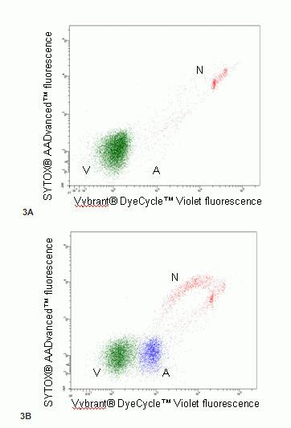
Chromatin Condensation Assay
Untreated
10 uM Camptothecin
A=apoptotic cells, V = viable cells, N = necrotic cells.
Invitrogen: http://tools.invitrogen.com/content/sfs/manuals/mp35135.pdf
Notes:
Green cells are viable, blue cells are apoptotic, and red cells are necrotic. These are Jurkat cells. I have not seen this technique used often in the literature.

Slide 29
Annexin V Assay
Timeline
1990 Andree at al. found that a protein, Vascular Anticoagulant α, bound to phospholipid bilayers in a calcium dependent manner. Protein was renamed Annexin V.
1992 Fadok et al. discovered that macrophages specifically recognize phospatidylserine (PS) that is exposed on the surface of lymphocytes during the development of apoptosis. This PS is normally on the inner leaflet of the membrane.
1994 Koopman et al. developed a flow cytometric assay for measuring FITC conjugated Annexin V binding to apoptotic cells. Stained control and serum starved cells with ethidium bromide and Annexin V-FITC.
Notes:
Andree: are located in the intracellular leaflet of the plasma membrane Activation of platelets or endothelial cells, or cell damage,
will expose these phospholipids to the coagulation factors in plasma.
Fadok: During normal tissue remodeling, macrophages remove unwanted cells, including those that have undergone programmed cell death, or apoptosis. This widespread process extends to the deletion of thymocytes (negative selection), in which cells expressing inappropriate antigen receptors undergo apoptosis, and are phagocytosed by thymic macrophages.
Koopman:Binding of annexin V is connected with apoptotic changes in nuclearmorphology, DNA fragmentation and membrane leaflet symmetry. Only cells that stain double positive demonstrate chromatin condensation. When cells are Ethidium bromide negative, they can still be Annexin V positive. Annexin V is an early marker of apoptosis. The exposure of phosphatidylserine on the surface of apoptotic cells has important implications. It triggers their specific recognition and removal by macrophages.’

Slide 30
Annexin V Assay
Normal Cell Membrane
No PS on surface.
Apoptotic Cell Membrane
PS on surface.
Apoptotic/Necrotic Cell
Membrane PS on surface,
membrane disintegrates.
Inner Leaflet
Inner Leaflet
Inner Leaflet
= Phosphatidylserine
Notes:
Cartoon of the apoptotic process. PS flips to cell surface, then the membrane begins to lose its integrity.
Phospholipids of the cell membrane are asymmetrically distributed between the inner
and outer leaflets of the membrane. Phosphatidylcholine and sphingomyelin are exposed
on the external leaflet of the lipid bilayer, while phosphatidylserine is located on the inner
surface. During apoptosis, this asymmetry is disrupted and phosphatidylserine becomes
exposed on the outside surface of the plasma membrane. Because the anticoagulant protein annexin V binds
with high affinity to phosphatidylserine, fluorochrome-conjugated annexin V has found
an application as a marker of apoptotic cells, in particular for their detection by flow
Cytometry.

Slide 31
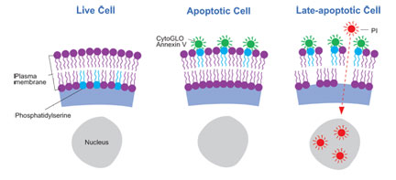
Annexin V Assay
Figure from Imgenex, CytoGLO Annexin V FITC kit
Notes:
Live cells do not bind Annexin V, early apoptotic cells have PS on the surface which binds the Annexin V conjugated to a fluorochrome, late apoptotic cells begin to lose membrane integrity and allow PI (which is a cell impermeant dye) to pass through and stain DNA.

Slide 32
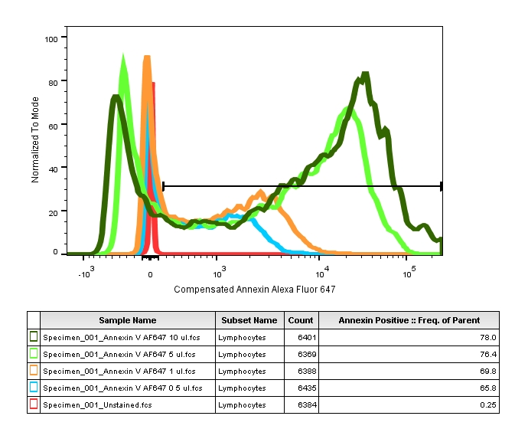
Annexin V Assay
Titrate the Annexin V.
10 ul Annexin V
5 ul Annexin V
1 ul Annexin V
0.5 ul Annexin V
Unstained

Slide 33
Annexin V Assay
Must perform compensation.
Annexin V-FITC vs. PI, negligible with 552 nm Green laser.
Annexin V can be conjugated to many other
fluorochromes. Compensation.
Your PI and Annexin V-FITC controls - apoptotic or necrotic for proper compensation.
If not, no Annexin V-FITC binding and PI cannot cross a healthy cell membrane.
Induce cell injury.
Notes:
Molecular Probe makes >10 different Annexin V versions off all sorts of lasers: UV, Violet, Blue, Green, Red…

Slide 34
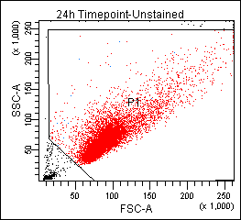
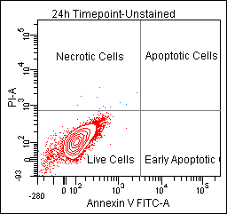
Annexin V Assay
Unstained Cells, no treatment, live cells
Data kindly provided by Patrick Grogan, Cohen Lab
Notes:
Here are my live cells, no PI or Annexin staining.

Slide 35
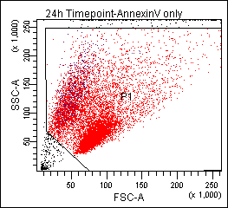
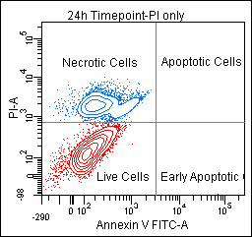
Annexin V Assay
Propidium Iodide Only, cells – not healthy
These cells were treated with withaferin A.
Notes:
PI only staining, very little if any compensation is necessary if using with Annexin- FITC.

Slide 36
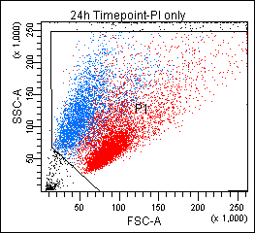
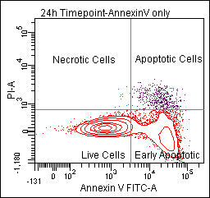
Annexin V Assay
Annexin-FITC Only, cells – not healthy
4.5%
These cells were treated with withaferin A. Your PI and
Annexin V cells must be apoptotic or necrotic for proper compensation.
Notes:
An issue with compensating apoptotic and necrotic cells is the cells are dying (of course), and dying cells may auto-fluoresce in different channels. In this case, 4.5% of the Annexin positive cells are leaking into the PI channel.

Slide 37
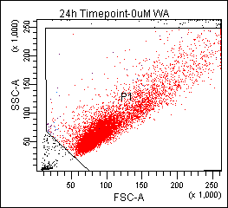
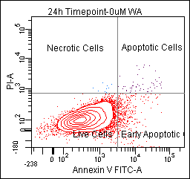
Annexin V Assay
Untreated, Annexin + PI
Notes:
The untreated cells are not apoptotic.

Slide 38
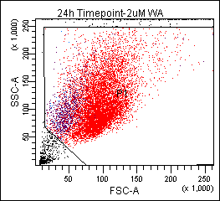
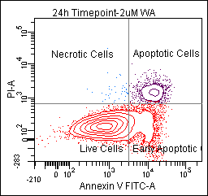
Annexin V Assay
2 uM WA Rx, Annexin + PI
8.4%
16.8%
Notes:
Here, we see the drug causing apoptosis. Notice that the violet cells, PI+ are becoming smaller. They are losing their membrane integrity, as the membrane deteriorates, the Annexin V staining will go away.

Slide 39
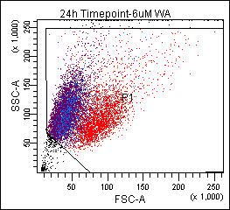
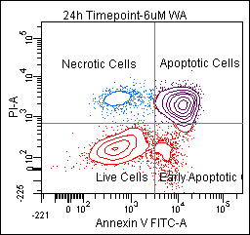
Annexin V Assay
6 uM WA Rx, Annexin + PI
5.8%
57.3%
30.1%
6.8%
Notes:
At the higher concentration of drug, necrosis can be seen as those cells are only PI+. The membranes are falling apart.

Slide 40
Annexin V Assay
Concerns
Very important to have negative and positive controls for live and apoptotic cells.
Trypsinization can lead to Annexin-binding. False positives.
Annexin V only binds in the presence of divalent cations (Ca²⁺ and Mg²⁺). Removal of the cations results in rapid dissociation of PS and Annexin.
An overly long incubation period - nonspecific binding.

Slide 41
MitoProbe JC-1 Assay
Mitochondria in Apoptosis
Intracellular energy – produced by mitochondrial respiratory chain.
Stored as an electrochemical gradient.
Trans-membrane electrical ΔΨ ~180 to 200 mV. Negative charge (inside).
The membrane potential (ΔΨ) of mitochondria drives the production of ATP.
A possible early apoptotic event is the collapse of the ΔΨ, or later after the loss of DNA integrity.
Notes:
Different mechanisms of apoptosis will effect that ΔΨ at different steps in the apoptosis cascade.

Slide 42
MitoProbe JC-1 Assay
JC-1
Lipophilic cation.
Excited by 488 nm laser.
Fluorescence emission changes based on ΔΨ and is reversible.
The dye forms aggregates (healthy) that emit at ~590 nm (red), while the monomeric form (apoptotic) emits at ~530 nm (green).
Aggregate formation starts at 80-100 mV and peaks at ~200 mV.
Red fluorescence means happy mitochondria, green fluorescence means a drop in ΔΨ.
Qualitative – shift from red to green.
Quantitative – measure absolute values of green and red emission.
Notes:
Cells with high ΔΨ will form JC-1 aggregates and fluoresce red, cells that fluoresce green have low ΔΨ and make monomeric JC-1.

Slide 43
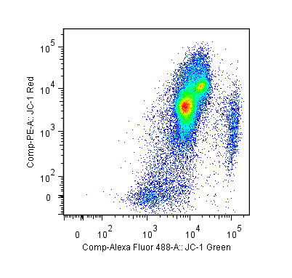
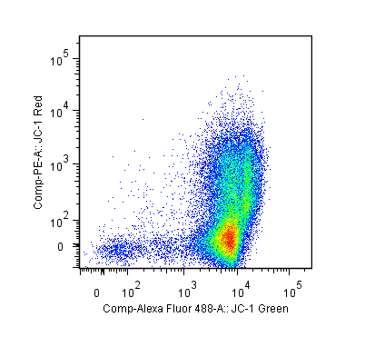
MitoProbe JC-1 Assay
Treat cells with Fccp. Fccp depolarizes the mitochondrial membrane potential and induces apoptosis.
Healthy PBMC
Fccp-treated PBMC
Red Median = 4029
Red Median = 83.5
Notes:
In healthy cells with high mitochondrial Δψm, JC-1 spontaneously forms complexes known as J-aggregates with intense red fluorescence. On the other hand, in apoptotic or unhealthy cells with low Δψm, JC-1 remains in the monomeric form, which shows only green fluorescence

Slide 44
MitoProbe JC-1 Assay
Concerns
The ΔΨ may be affected by a multitude of factors.
Apoptosis can be triggered by many different stimuli, effecting many intracellular systems.
Apoptotic DNA fragmentation may occur before a change in mitochondrial ΔΨ, in this instance, the change in ΔΨ is because of apoptosis, not a trigger of apoptosis.
We can stain cells for extracellular markers, as well as JC-1, but care must be taken to compensate properly.
Notes:
Cells with high ΔΨ will form JC-1 aggregates and fluoresce red, cells that fluoresce green have low ΔΨ.

Slide 45
Apoptosis
How can the flow core assist you?
We can help you set up your assays.
Our website has apoptosis protocols.
We have experimental templates for most common apoptosis assays.
We have examples of successfully accomplished experiments.
We know the reagent vendors (samples, tech assistance).

Slide 46
Apoptosis
How can the flow core assist you?
We have reagents to get you started!!!!!!!
Name | Vendor | Catalog | Excitation (nm) | Emission (nm)
7-AAD | Invitrogen | A1310 | 488, 546 max | 647
7-AAD | Beckman Coulter | A07704 | 488, 546 max | 647
Annexin V FITC | Life Technologies | A13199 | 494 | 518
Annexin V, Alexa Fluor 647 | Invitrogen | A23204 | 650 | 665
Annexin V binding buffer (5x) | Invitrogen | V13246 | - | -
Camptothecin | Sigma | C9911 | - | -
DAPI | Invitrogen | D1306 | 358 | 461
DAPI | Invitrogen | D3571 | 358 | 461
DAPI | Pierce | 46190 | 358 | 461
Propidium Iodide | Life Technologies | P3566 | 535 | 617
Propidium Iodide (FluroPure grade) | Invitrogen | P21493 | 535 | 617
SYTOX Green dead cell Stain | Molecular Probes | S34860 | 504 | 523
TUNEL kit | Roche | 11 684 785 910 | 494 | 518

Slide 47
References
Andree, H. A. M. et al. (1990) Binding of Vascular Anticoagulant α (VAC α) to Planar Phospholipid Bilayers. The Journal of Biological Chemistry 265, 9, 4923-4928.
Cassarizza, A et al. (2000) Flow Cytometric Analysis of Mitochondrial Membrane Potential using JC-1. Current Protocols in Cytometry 9.14, 1-7.
Elmore, S. A. (2007). Apoptosis: a Review of Programmed Cell Death. Toxicol Pathol 35 (4):495-516.
Janeway’s Immunology, Seventh Edition, 2008.
Fadok, V. et al. (1992) Exposure of Phosphatidylserine on the Surface of Apoptotic Lymphocytes triggers specific recognition and removal by Macrophages. The Journal of Immunology 148, 2207-2216.
Koopman, G. et al. (1994) Annexin V for Flow Cytometric Detection of Phosphatidylserine Expression on B cells undergoing Apoptosis. Blood 84, 1415-1420.
Lugli, E. et al. (2007) Polychromatic Analysis of Mitochondrial Membrane Potential using JC-1. Current Protocols in Cytometry 7.32, 1-15.

Slide 48
References
Packard, B. et al. (2008) Intracellular Protease Activation in Apoptosis and Cell-mediated Cytotoxicity Characterized by Cell-permeable fluorogenic protease substrates. Cell Research 18, 238-247.
Pozarowski, P. et al. (2003) Flow cytometry of Apoptosis. Current Protocols in Cytometry, 7.19, 1-33.
Telford, W. et al. (2004) Chapter 8: Multiparametric analysis of apoptosis by flow and image cytometry. Methods in Molecular Biology: Flow Cytometry Protocols, 2nd ed. 141-159.
Wlodkowic, D. et al. (2010). Cytometry in Cell Necrobiology Revisited. Recent Advances and New Vistas. Cytometry 77A: 591-606.

